Slide 1
Everything You Have Always Wanted to Know About Behavior Supports, But Were Afraid to Ask
Tim Lewis, Ph.D.
University of Missouri
OSEP Center on Positive
Behavioral Intervention & Supports
pbis.org

Slide 2
Big Ideas
Understand interaction between behavior and the teaching environment
Build Positive Behavior Support Plans that teach pro-social “replacement” behaviors
Create environments to support the use of pro-social behaviors
  School-wide
  Classroom
  Individual student

Slide 3
Evidence-Based Practices
Academic
  Peer tutoring
  Direct Instruction
  Self-management targeting academic related skills
  Opportunities to Respond

Slide 4
Evidence-Based Practices
Behavior
  Environmental modifications and supports
  Contingent positive performance based feedback
  Self Management
  Social Skill Instruction (with maintenance and generalization strategies)

Slide 5
Evidence-Based Practices
Related Supports
  Comprehensive case management
  Integrated systems
  Family supports/ parent training

Slide 6
Connections to Mental Health and Community Agencies
www.pbis.org/school/school-mental-health/interconnected-systems

Slide 7
Turn & Talk
How is your district determining what are “evidence-based” practices?

Slide 8
Putting Evidence-Based Practices In Place
Systems
Systems
Systems
Prevention, Early Intervention and Individualized Student Supports through Positive Behavior Support

Slide 9
School-wide Positive Behavior Support
Problem solving framework
Systematic implementation of evidence-based practices
Layers in increasingly more intensive environmental supports to increase the likelihood students are academically, emotionally, and socially successful

Slide 10
Social Competence &
Academic Achievement
SW-Positive
Behavior
Support
OUTCOMES
Supporting
Decision
Making
Supporting
Staff Behavior
SYSTEMS
DATA
PRACTICES
Supporting
Student Behavior

Slide 11
Designing School-Wide Systems for Student Success
Academic Systems
Behavioral Systems
Intensive, Individual Interventions
Individual Students
Assessment-based
High Intensity
Intensive, Individual Interventions
Individual Students
Assessment-based
Intense, durable procedures
1-5%
1-5%
Targeted Group Interventions
Some students (at-risk)
High efficiency
Rapid response
5-10%
5-10%
Targeted Group Interventions
Some students (at-risk)
High efficiency
Rapid response
Universal Interventions
All students
Preventive, proactive
80-90%
80-90%
Universal Interventions
All settings, all students
Preventive, proactive

Slide 12
Universal
Targeted
Intensive
Continuum of Supports
Math
Science
Spanish
Soc skills
Reading
Horses
Notes:
NOTICE GREEN GOES IS FOR “ALL”

Slide 13
Classroom Supports

Slide 14
Classroom Universal Essential Practices
Classroom expectations & rules defined and taught (all use school-wide, create classroom examples)
Procedures & routines defined and taught
Continuum of strategies to acknowledge appropriate behavior in place and used with high frequency (4:1)
Continuum of strategies to respond to inappropriate behavior in place and used per established school-wide procedure
Students are actively supervised (pre-corrects and positive feedback)
Students are given multiple opportunities to respond (OTR) to promote high rates of academic engagement
Activity sequence promotes optimal instruction time and student engaged time
Instruction is differentiated based on student need

Slide 15
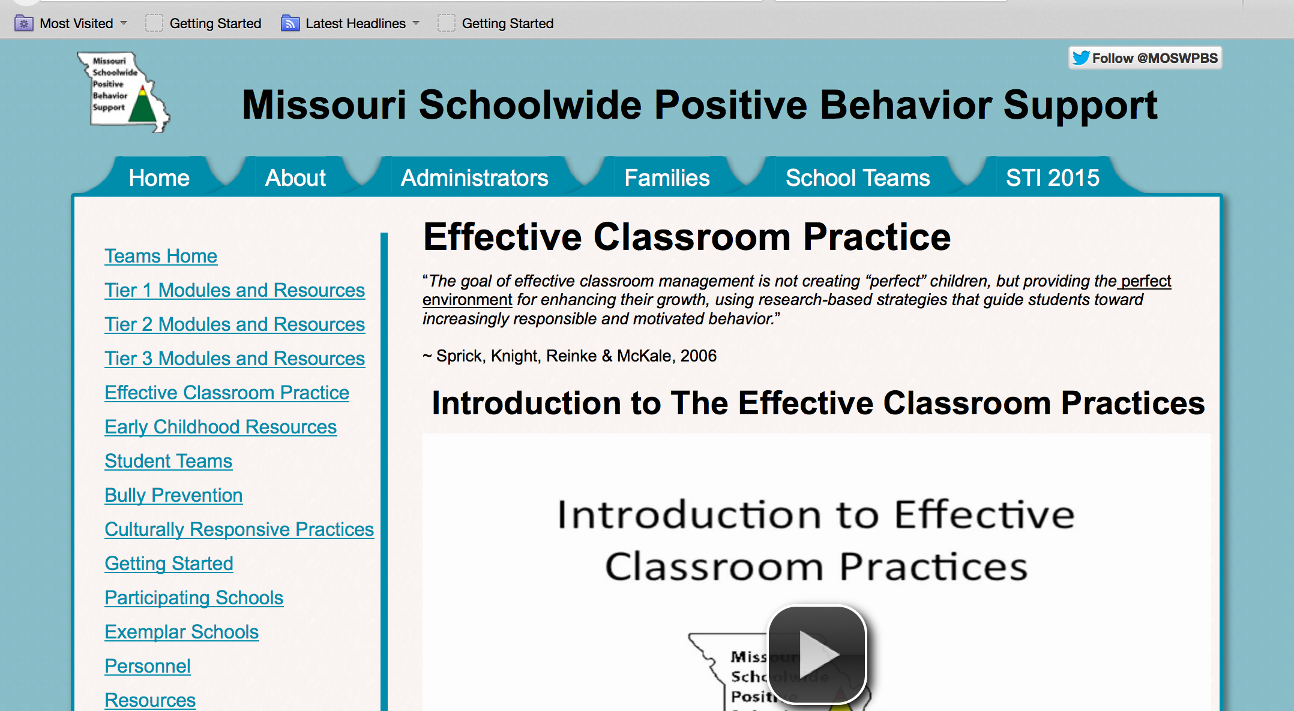
http://pbismissouri.org/educators/effective-class-practice

Slide 16

Typical School Day
17% Direct Instruction
33% Seatwork
20% Transitions
30% Discipline & Other
Non-Instructional
Activities
Cotton, 1995; Walberg, 1988
MO SW-PBS
324
Notes:
Note to Presenter: See page 324 in the MO SW-PBS 2012-13 Team Workbook for further explanation of academic learning time.
When the amount of time spent in various classroom activities was researched only 17% was spent in instruction and 33% in seatwork.
Transitions take 20% of the school day. The typical elementary classroom loses 7-10 minutes each transition from one subject to another; with a typical day including at least 10 transitions, 70 minutes are lost each day; almost one day per week lost to transitions alone.
Unfortunately discipline and other non-instructional activities such as taking attendance, announcements, etc, accounted for 30% of the school day.
Think about your typical day and the time you spend in various activities. How does it compare to these statistics?
Why is this information relevant to us? (discipline takes away from time to teach academic curriculum)
Conclusion: We want to implement effective classroom practices to prevent and decrease interruptions caused by discipline problems and increase the amount of time we have to teach.

Slide 17

Activity: Classroom Rule Writing Activity Option 1
List problem behaviors in your classroom
List replacement behavior (what we want kids to do instead)
List schoolwide expectations
Categorize rules within schoolwide expectations
Notes:
This activity is for schools who have NOT identified classroom expectations/rules as a column on their matrix. If your school has not addressed classroom rules in any way, you should do this activity… You will need two handouts: 1) Rules Writing Worksheet Example 2) Rules Writing Activity Classroom Rules Worksheet
If your school has identified CLASSROOM expectations/rules that apply to all classrooms in the building, then you will skip Activity Option 1 and complete Activity Option 2 instead.
For Activity Option 1…
First, look at handout Rules Writing Worksheet Example. This can be used as an example while you complete your own rules on handout entitled Rules Writing Activity Classroom Rules Worksheet
Next, using handout Rules Writing Activity Classroom Rules Worksheet, list your schoolwide expectations (safe, respectful, ready)
Then list problem behaviors in your classroom. The behaviors that take time away from learning.
After you have listed problem behaviors, identify the replacement behaviors or what you want students to do instead of the problem behavior.
Remember the guidelines we shared earlier,
Observable
Measureable
Positively stated
Understandable
Always applicable – Something the teacher will consistently enforce
Finally, categorize your replacement behaviors/positively stated rules into your schoolwide expectations. It is important to make that connection.
Give participants 15 - 20 minutes to work on this activity. Discuss when finished.

Slide 18
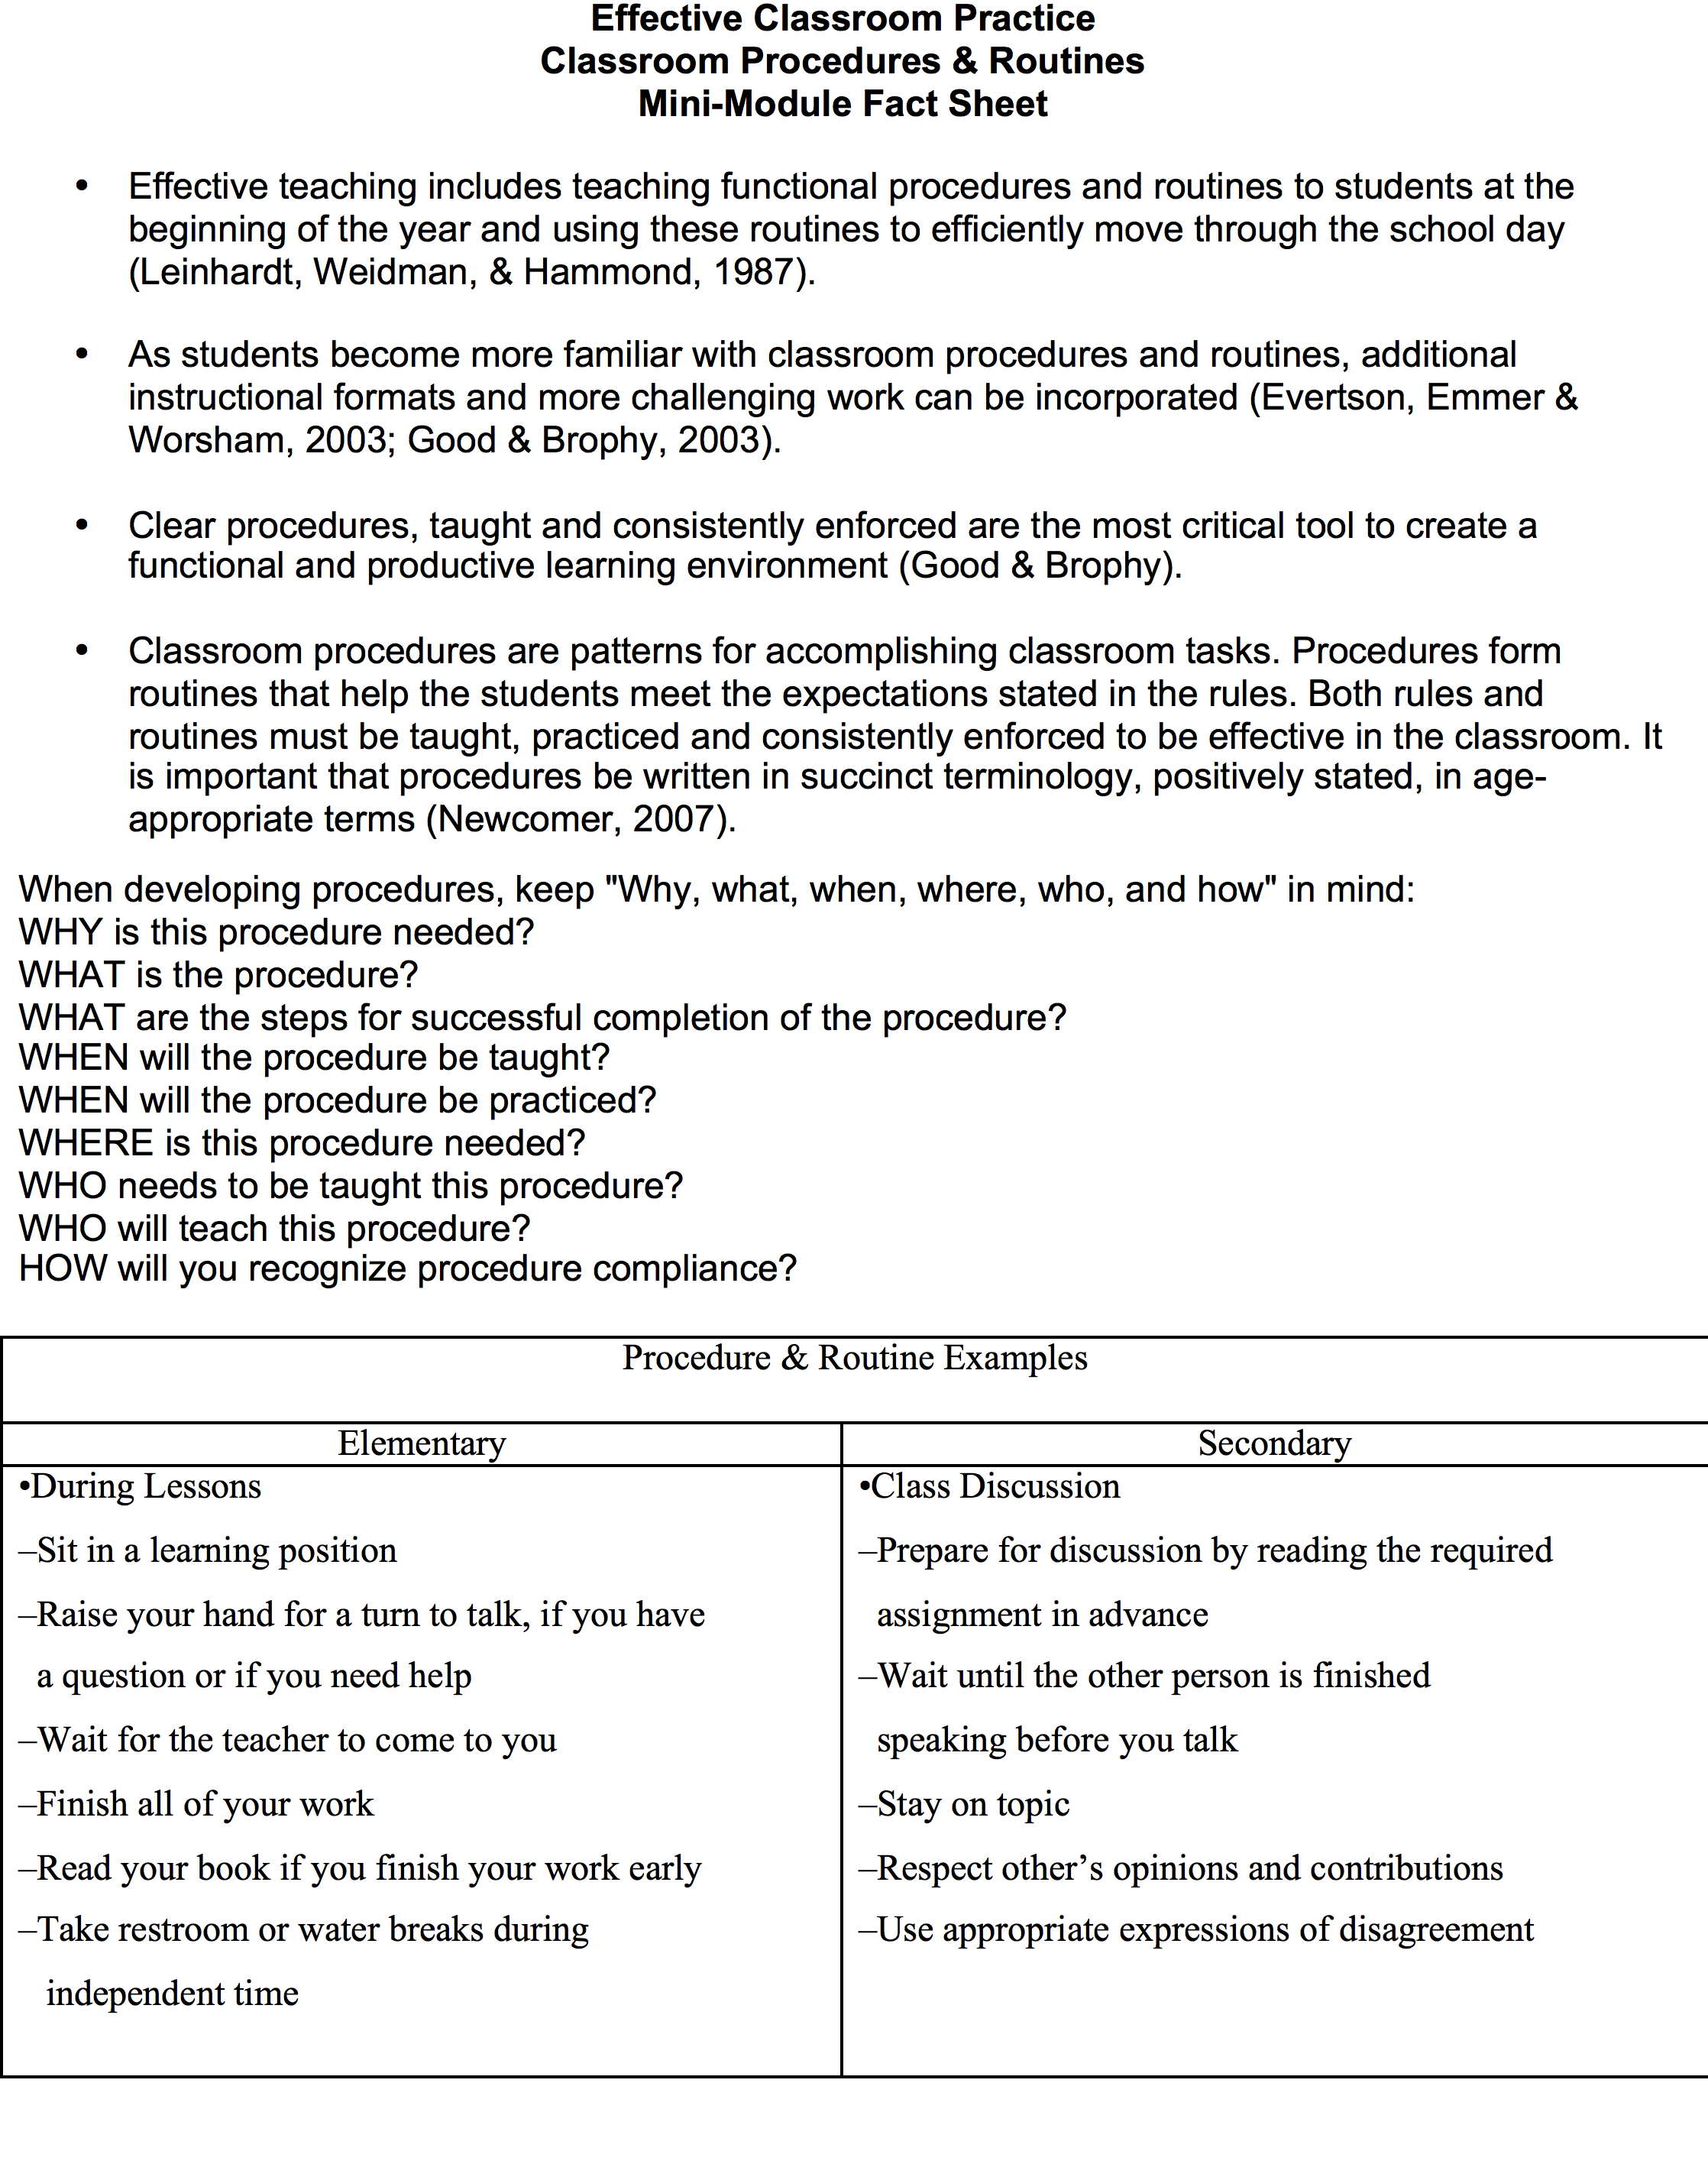

Slide 19
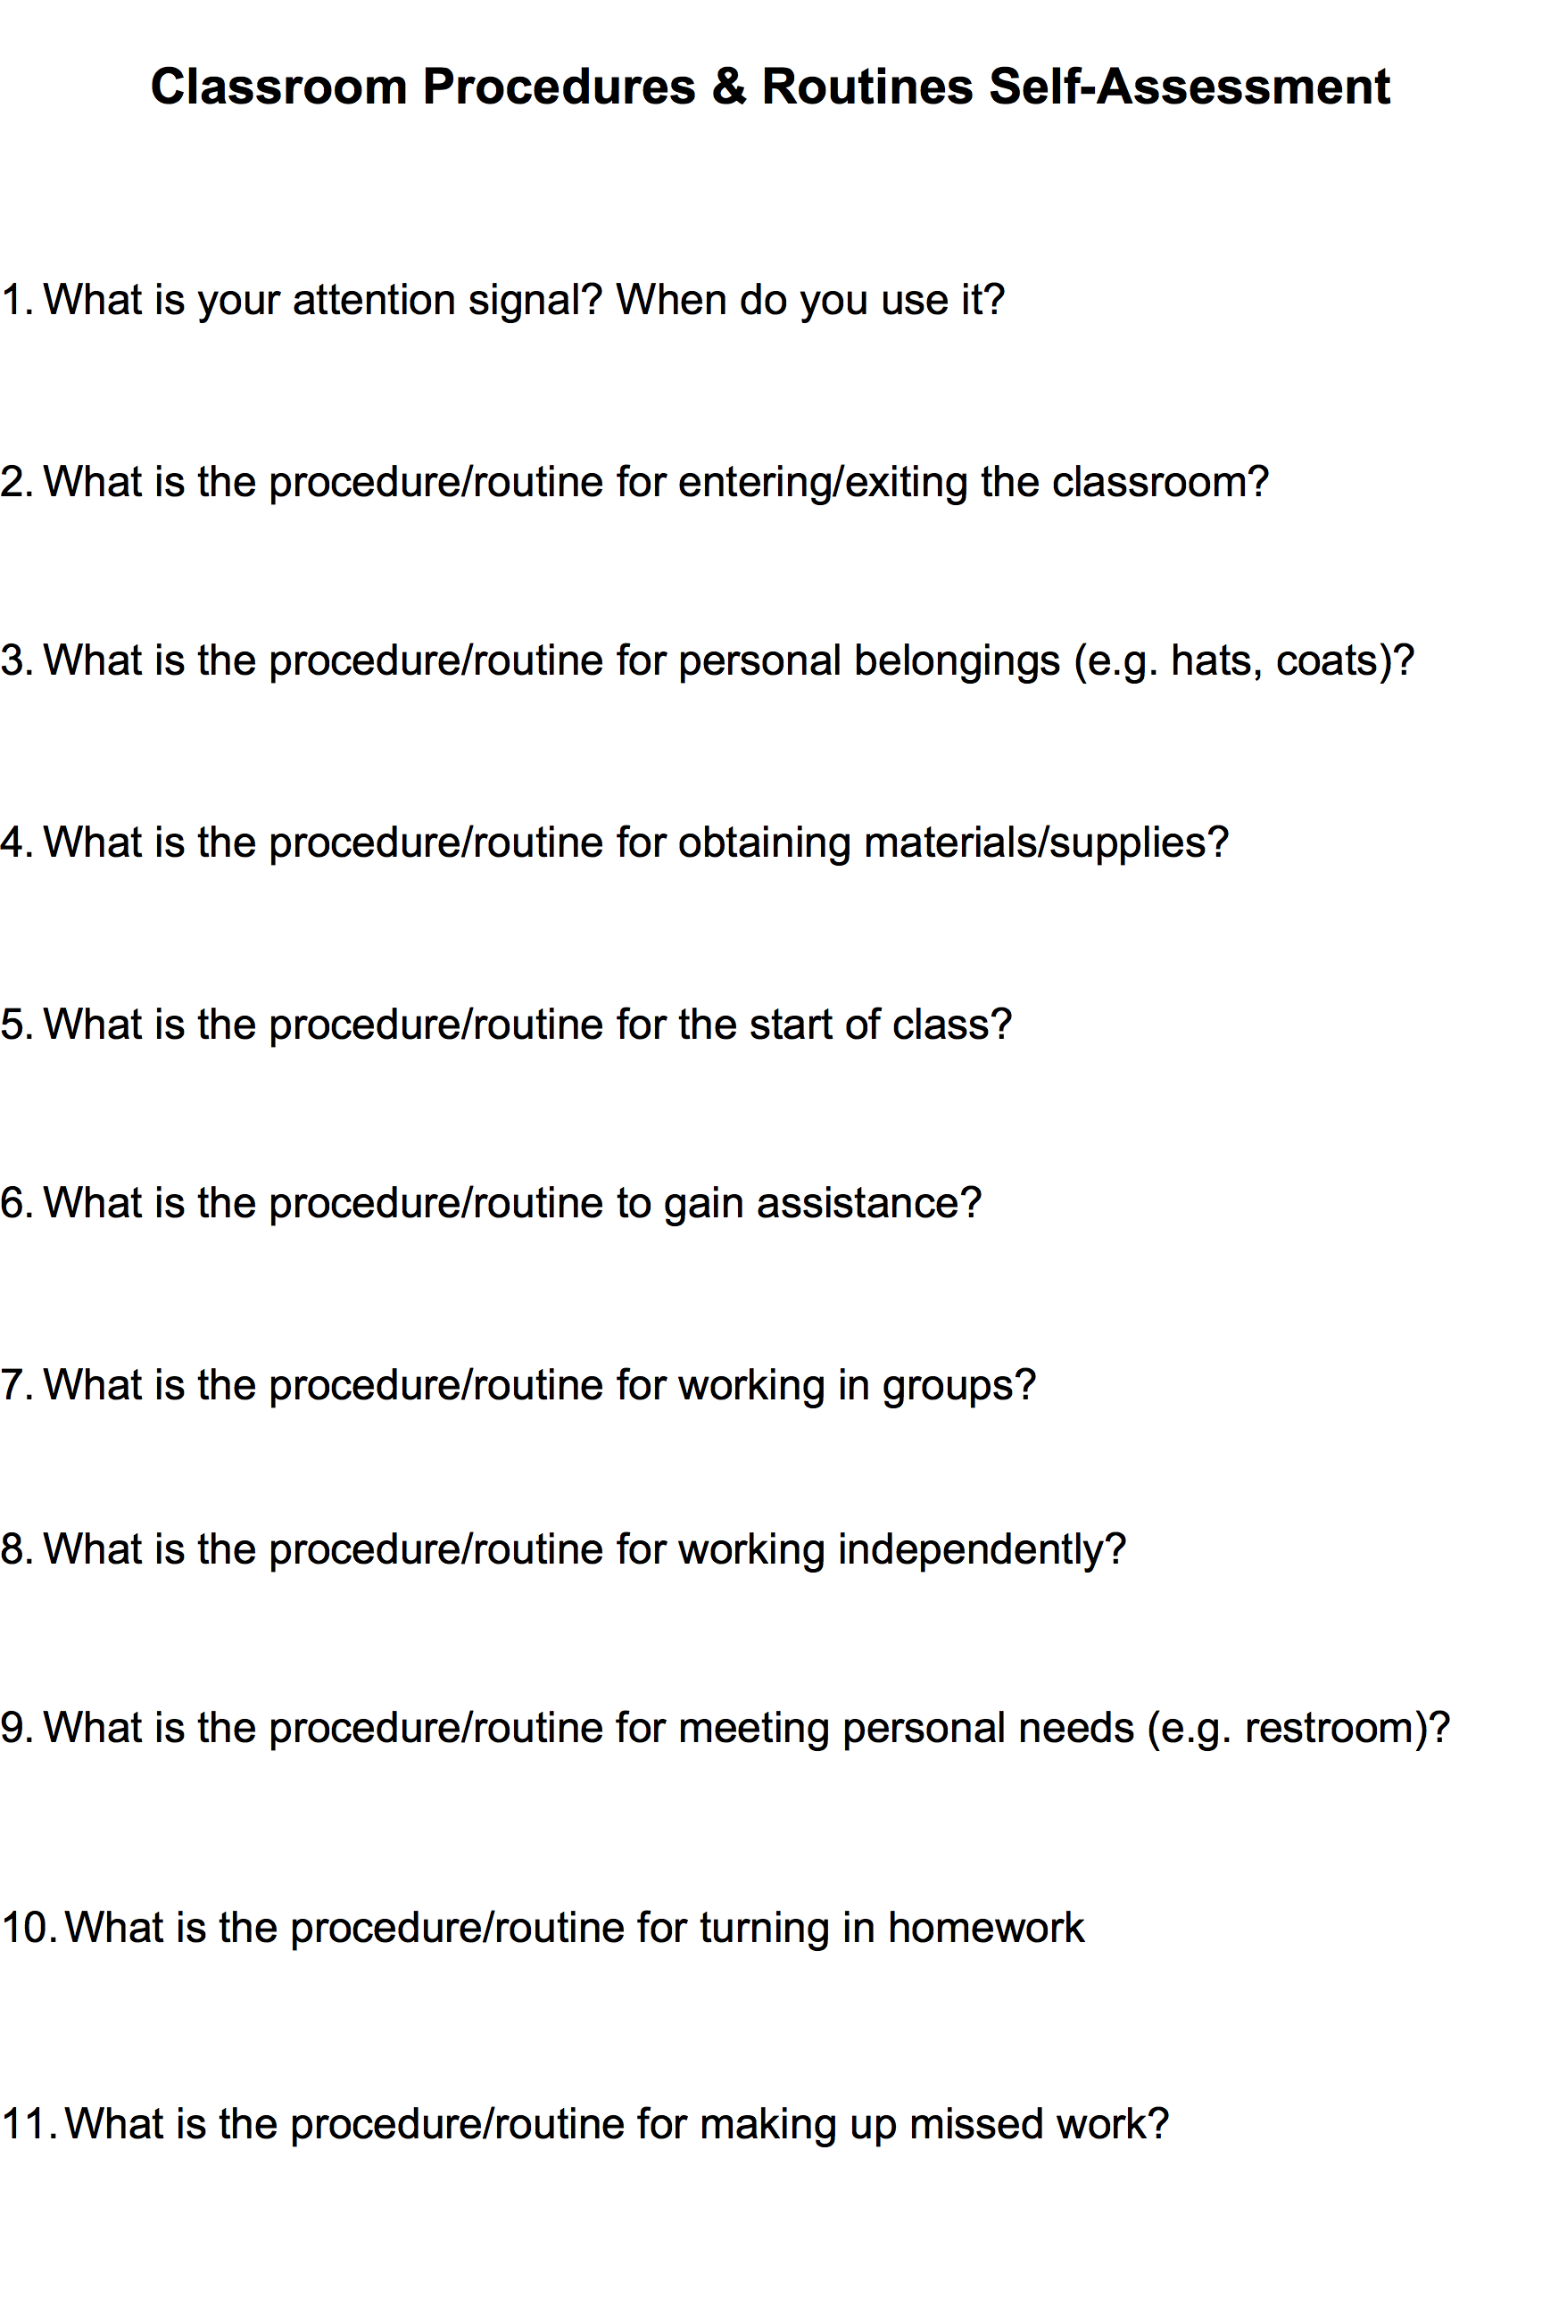

Slide 20
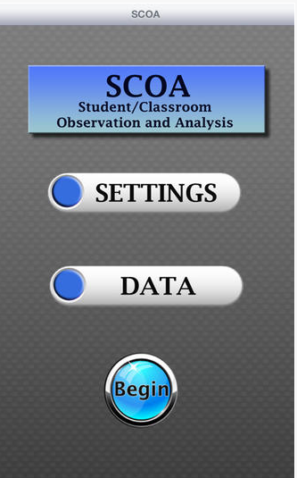
Classroom Systems
Teach
  Brief in-service, single topic focus
Practice (performance feedback)
  Peer coaching
  Principal “walk through”
  Direct observation / data collection
Notes:
20

Slide 21
Universal Classroom Example

Slide 22
The Beginning – Background Info.
School used a universal screening instrument in October of 2012.
Results indicated that 32.3% of students were in the at-risk or high-risk range.
Team decided to focus first efforts on implementation of Tier 1 with higher levels of fidelity.

Slide 23
Baseline Data Collection
Classroom-Level Observations of Effective Classroom Practices
    Expectations & Rules
    Procedures & Routines
    Encouraging Expected Behavior
    Discouraging Inappropriate Behavior
    Active Supervision
    Opportunities to Respond
Based on data, team identified 1 practice to improve upon.
Initial ratio of positive specific feedback to correctives: 1.85:1

Slide 24
Professional Development Process & Data
January 2013 – Staff Professional Development on Positive Specific Feedback
February 2013 – Follow-up Classroom Observations, Ratio at 2.44:1
March 2013 – Additional Staff Professional Development with Increased Practice and Supports
May 2013 – Final Classroom Observations of the School Year, Ratio at 6.55:1
October 2012 – Initial Observations, Ratio at 1.85:1

Slide 25
End of Year Outcomes
ODRs decreased by 39.41% from 2011-2012 to 2012-2013.
Minor referrals decreased by 34.8% from 2011-2012 to 2012-2013.
Classroom minor referrals decreased by 33.5% from 2011-2012 to 2012-2013.

Slide 26
Tier III Classroom Example
Stichter, J. P., Lewis, T. J., Johnson, N., & Trussell, R. (2004). Toward a structural assessment: Analyzing the merits of an assessment tool for a student with E/BD. Assessment for Effective Intervention, 30, 25-40.

Slide 27
Study Basics
Subject:
  Seven years old
  Identified with EBD and ADHD
Setting
  General education 2nd grade classroom with 19 other students
  One licensed teacher and one student teacher
Concern
  Student exhibits high rates of off-task
  Student shouts out answers and questions and comments at high rates and often inappropriate

Slide 28
“Function of Behavior”
Descriptive (interviews and teacher reported ABC/ Scatterplot data)
  Function identified as Attention
  Significant antecedents: multiple step direction and group settings
  Very High rates of both problem behaviors reported/ inconsistency in accuracy of data collection

Slide 29
“Environment Assessment”
Significant variables:
clarity of expectations & directions
consistency of expectations
accessibility of class schedules
lack of enforced procedures (especially regarding to hand raising and verbalizations or entire class)

Slide 32

http://coe.lehigh.edu/cars

Slide 33
Classroom Assessment Targets
Classroom Structure
  Rules and routines
Improving Teacher-Student Interactions
Evidence-Based Academic Instruction
  Opportunities to Respond (OTR)
  Incorporating students’ choice and interests
  Accommodations
Responding to problem behavior
Accommodations

Slide 34
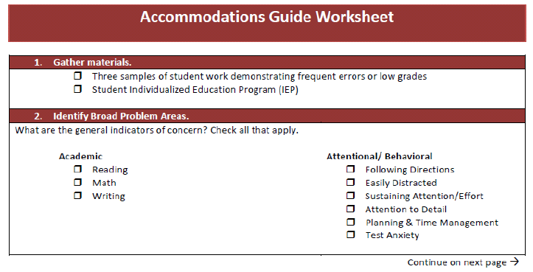
Accommodations Guide Model

Slide 35
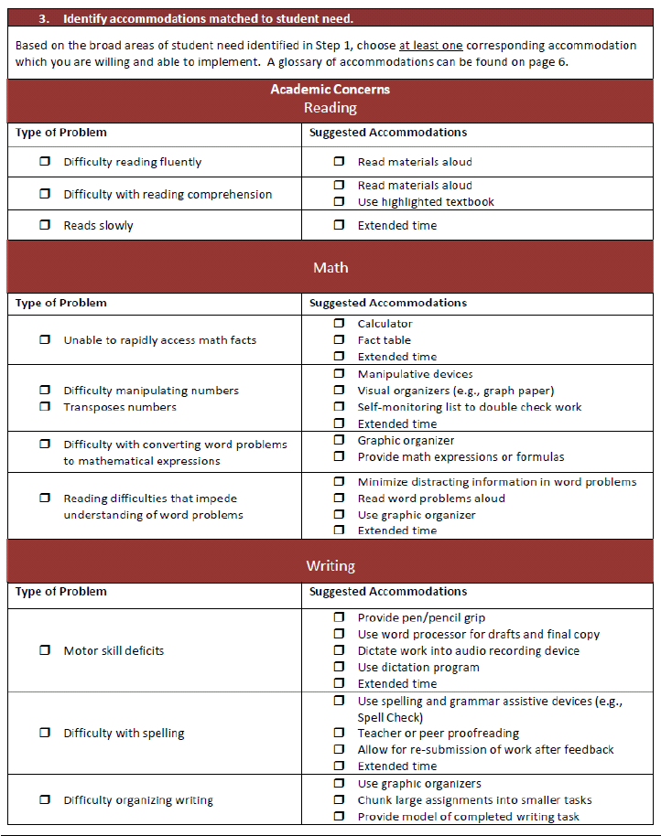

Slide 36
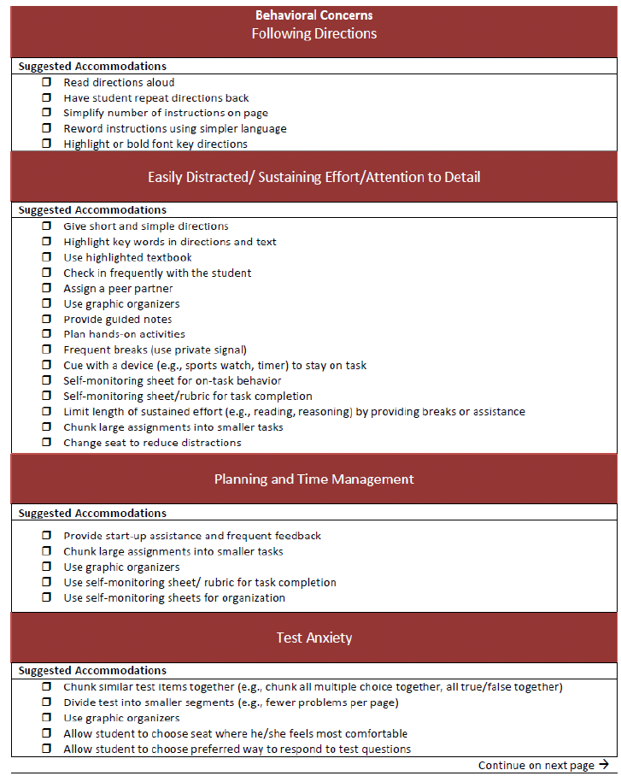

Slide 37
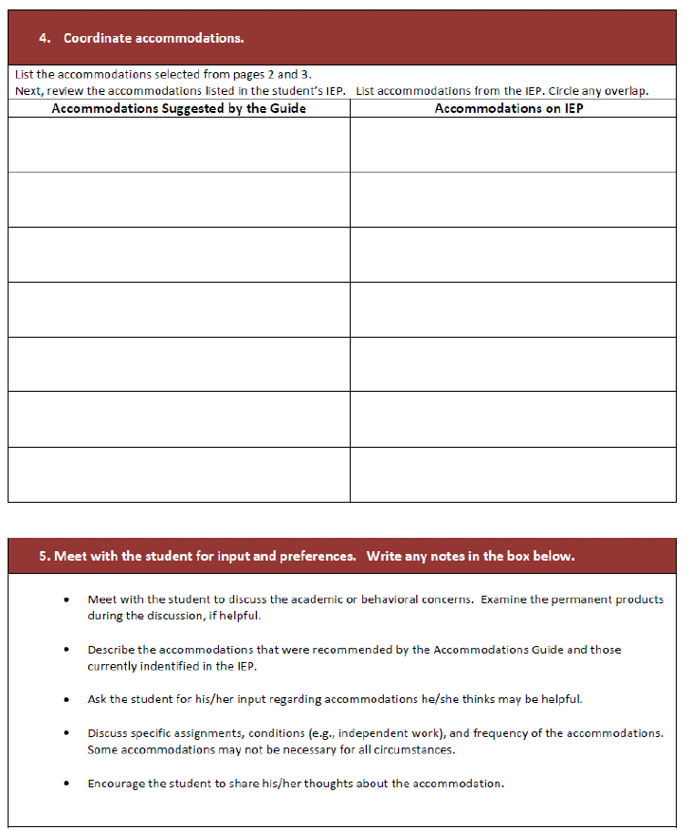

Slide 38
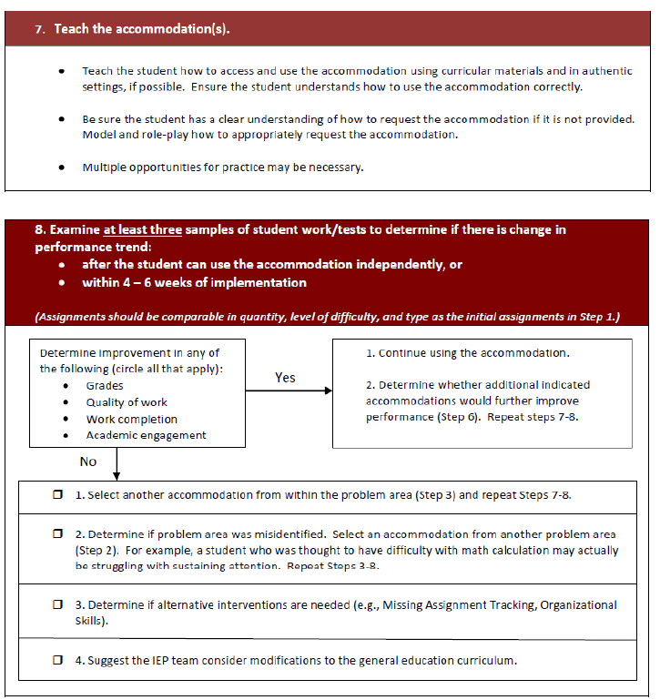

Slide 39
CASE Study

Slide 40
Participant Description
Externalizing behaviors
Low academic abilities
  3rd Grade academic functioning
General education co-taught History class
Teacher selected interventions (based on feasibility)
  Accommodations
  Positive Teacher/Student Interactions

Slide 41
Model Implementation
Step #1:
Collect three samples of student work demonstrating frequent errors or low grades.
Identify accommodations provided in IEP

Slide 42
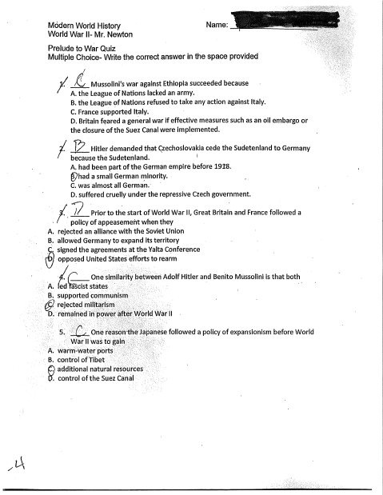

Slide 43
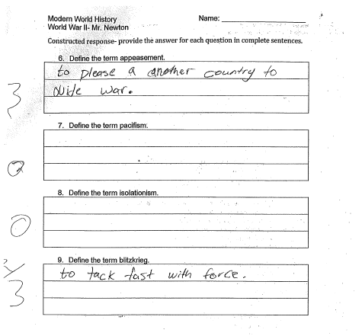

Slide 44
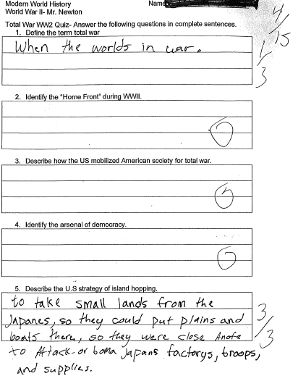

Slide 45
Student IEP Accommodations
Testing:
  Alternative setting
  Extended time for completion
  Read test to student (if requested)
Assignments and Instruction:
  Lower difficulty level-shorten assignments
  Provided structured time to organize materials
  Frequent reminders of rules
  Check often for understanding/review
  Extended time for oral responses
  Extended time for written responses
  Maintain assignment notebook
  Bathroom break first 5 mins. of class, unless emergency
  Use lined paper for written assignments
  Assist or provide notes and study guides
  Extended to create assignments (1 ½ weeks or as agreed upon w/ teacher)

Slide 46
Step #2:
Identify general indicators of concern
  Writing, specifically difficulty organizing writing
    “Couldn’t complete short answer”
  Attention to detail
    “Chose wrong answers on multiple choice and selected obviously wrong answers”
  Planning and time management
    “Ran out of time to complete the test even when given multiple class periods”

Slide 47
Step # 3
Identify accommodations matched to student’s needs
  Writing: Difficulty Organizing Writing
    Graphic Organizers
  Attention to Detail
    Assign a Peer Partner
    Use Graphic Organizers
    Chunk Large Assignments into Smaller Tasks
  Planning and Time Management
    Chunk Large Assignments into Smaller Tasks
    Graphic Organizers

Slide 48
Step # 4: Coordinate accommodations
Model Accommodations
Writing: Difficulty Organizing Writing
  Graphic Organizers
Attention to Detail
  Assign a Peer Partner
  Use Graphic Organizers
  Chunk Large Assignments into Smaller Tasks
Planning and Time Management
  Chunk Large Assignments into Smaller Tasks
  Graphic Organizers
IEP Accommodations
Testing-
  Alternative Setting
  Extended time for completion
  Read test to student (if requested)
Assignments and Instruction-
  Lower Difficulty Level-Shorten Assignments
  Provided Structured Time to Organize Materials
  Frequent Reminders of Rules
  Check often for understanding/review
  Extended time for Oral Responses
  Extended time for Written Responses
  Maintain Assignment Notebook
  Bathroom Break first 5 mins. Of class, unless emergency
  Use lined paper for written assignments
  Assist or Provide Notes and Study Guides
  Extended to create assignments (1 ½ weeks or as agreed upon w/ Teacher)

Slide 49
Step #5:
Meet with the student for input and preferences
  Student agreed with teachers concerns.
  Student agreed to all suggested accommodations.
  Student requested:
    A different seat with less distractions during independent work.
    Materials if he forgot to bring them.

Slide 50
Step #6:
List accommodations to be implemented and evaluated.
Prioritize
Determine instruction or testing
Define and describe conditions:
  1) Use graphic organizers (I/T) All in class work, Teacher-created or pre-made organizers.
  1) Change seat to reduce distractions (I/T) Student and teacher will meet to discuss alternative seat, can be changed if student does demonstrate classroom expectations.
  1) Materials be given to student if forgotten (e.g. pencil) (I/T) Student must request material at the start of the class and give teacher collateral for the return of material at the end of the class period.
  2) Assign a peer partner (I) All in-class work with a teacher chosen partner.
  3) Chunk large assignments into smaller tasks (I) All in class assignments spanning multiple class periods with a teacher-created checklist of completed tasks.

Slide 51
Step #7:
Teach the accommodations
  Assign a peer partner
    What are the appropriate behaviors of working with a peer?
    What noise level can you work with a peer?
    What does helping vs. doing look like?
  Use graphic organizers
    How do I use graphic organizers (5 paragraph outline, flow chart, venn diagram, checklist, etc.)?
  Chunk large assignments into smaller tasks
    How do I use a checklist?
    How do I manage my time?
  Change seat to reduce distractions
    How do I transition?
    When is it appropriate to move?
  Materials given to student if forgotten (e.g. pencil)
    How do I know what materials I need?
    What is appropriate collateral?

Slide 52
Step #8:
Examine at least three samples of student work/tests to determine if there is a change in the performance trend
  Class Grade Increased from a 24% to a 77%
  Highest class grade he had received since beginning high school!

Slide 53
Turn & Talk
What are some common accommodations used in your school or district?
Is there a system in place to determine appropriate accommodations & technical assistance available for teacher implementation?

Slide 54
Function-Based Logic: Guiding Individual Behavior Plans

Slide 55
What is a Functional Behavioral Assessment
“A process for gathering information used to maximize the effectiveness and efficiency of behavioral support” (O’Neil et al.)

Slide 56
Why Conduct a Functional Behavioral Assessment

Slide 58
The Key
Behavior is functionally related to the teaching environment

Slide 59
Basics
Focus on observable behavior
  Label free approach
  Acknowledgement of other factors
Instructional approach
Emphasis on understanding the principles of behavior not specific forms or “cook book” strategies
Rule out other explanations
Move from personal experience with “discipline”

Slide 60
Moving beyond the form of behavior...

Slide 61
The Basics
Behavior is learned
Do not assume children know your rules, expectations, or social skills
Every social interaction you have with a child teaches him/her something

Slide 64
Function-based Logic
Children engage in behavior(s) to "get" what they find reinforcing or to "avoid" what they find aversive

Slide 65
Functional Assessment
Pre-Assessment/Indirect
Interviews
Rating Scales
Student Guided
Direct Observation
A-B-C
Checklists

Slide 66
Hypothesis
When this occurs….
The student does….
To get/avoid...

Slide 67
Functional-Based Interventions (BIP)
Teach replacement behavior(s) that result in same/similar outcome
Replacement behavior should be more efficient than problem behavior
Environment should not allow problem behavior to result in previous outcomes

Slide 68
Setting Events | Predictors | Behavior | Consequences
• Playground monitor debriefs student prior to coming into building. | • Change seating arrangement during reading class. • Pre-correct class RE rules of cooperative groups. | • Set up cooperative peer groups. • Identify appropriate peers and teach cooperative strategies. • Teach rules and skills of cooperative groups to target student. • Role play cooperative learning with peers and target student. • Monitor progress (momentary time sampling) | • Verbal praise when on-task (VI 3 minutes). • Error correction for off-task. • Free time with peers for meeting established daily criteria.

Slide 69
For More Information
OSEP Center for Positive Behavioral Interventions and Supports
pbis.org
Missouri School-wide Positive Behavior Support
pbismissouri.org
Center for Adolescent Research in Schools
coe.lehigh.edu/cars
IDEAS that Work
osepideasthatwork.org
What Works Clearinghouse
Ies.ed.gov/ncee/wwc

