Slide 1
Culturally Proficient Educational Practice: Changing the Conversation
Summit on School Climate and Culture
Randall Lindsey
August 8 & 9, 2016

Slide 2
Learning Agreements
Tech check – use appropriately,
Hand signals, chimes
Be 100% present,
Participate to seek to understand,
Learn about self and others and
Enjoy the day!

Slide 3
Intended Outcomes
Participants to view Cultural Proficiency as a shared priority;
Participants to experience Cultural Proficiency as personal and professional work;
Participants to use the lens of Cultural Proficiency as a guide with colleagues in addressing access and achievement gap issues; and
Participants to use Tools of Cultural Proficiency to build professional capital for changing conversations.

Slide 4
Agenda – Triple Track
Use strategies to support our learning today;
Explore applications for these strategies with adult groups as facilitators within our communities; and
Consider application of these strategies in classrooms focused on student achievement.

Slide 5
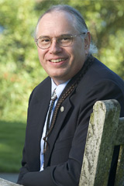
In Appreciation
Terry Cross

Slide 6
Our ‘Community of Practice’
Raymond Terrell, Kikanza Nuri, Delores B. Lindsey,
Randall B. Lindsey, Brenda CampbellJones,
Franklin CampbellJones, Laraine Roberts,
Richard S. Martinez, Stephanie Graham,
R. Chris Westphal, Jr., Cynthia Jew, Linda Jungwirth,
Jarvis Pahl, Keith Myatt, Michelle Karns, Diana Stephens, Carmella Franco, Maria Ott, Darline Robles,
Reyes Quezada, Richard Diaz, Karen Kearney,
Delia Estrada, Trudy Arriaga, Lewis Bundy,
Tracey DuEst, Ian Jones, John Krownapple, and
Fernando Rodriguez-Valls.
Notes:
CHANGED: Added space between point and name - grazzi

Slide 7
What’s in a Name? An Inclusion Activity – Manual 3rd Ed, p 217
Find 2 discussion partners who you do not know well
Wait for us to model activity
Share
Your complete name
Your preferred name
Who gave you your name
How you experience your name
How you think others experience your name
Notes:
Pair/Balance w/ Opening where participants will likely share name, district – in triads or quads; not to total group.

Slide 8
Cultural Proficiency Framework Uses Four Unique Tools
The Barriers
Caveats that assist in responding effectively to resistance to change
The Guiding Principles
Underlying values of the approach
The Continuum
Language for describing both healthy and non-productive policies, practices and individual behaviors
The Essential Elements
Five behavioral standards for measuring, and planning for growth toward cultural proficiency
Notes:
• Shortened title: From “The Framework for Cultural Proficiency Uses...” (opened visual space)
• Eliminated comma (in last point)
• Differentiated points from text w/ italics (and bold) (and underline)
• Indented second line of description to add white space – another THANK YOU!

Slide 9
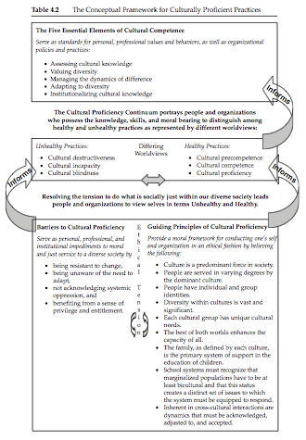
Examining the Conceptual Framework
Overcoming
Notes:
Delores
Process: examine conceptual framework, and talk to an elbow partner as to what sense it makes to you.
Build this with circles
Guiding principles, Overcoming Barriers (put in “overcoming”)
Continuum
5 essential elements

Slide 10
Cultural Proficiency
An inside-out approach that is about...
Being aware of how we - as individuals and as schools - work with others
Being aware of how we respond to those different from us
Visible and not so visible differences
Preparing to live in a world of differences
Is a worldview, a mindset; it is the manner in which we lead our lives
Can NOT be mandated, but can be nurtured
Notes:
CHANGED: text and font size to increase visual space
Consider: ”An inside-out approach and today’s theme”
Consider: eliminating “Is about” from slides, but not from verbal; “A worldview, a mindset; the manner in which... – We kept your edited slide and deleted origjnal slide. Thank you.

Slide 11
Cultural Proficiency functions as…
A lens, through which to view your work
The manner in which we lead our lives.
Notes:
CHANGE: Added space after point

Slide 12
Reflection and Dialogue
Reflection and Dialogue are essential processes for individuals and organizations engaged in a journey toward Cultural Proficiency:
Reflection is the discussion we have with ourselves to understand our values and behaviors
Dialogue is the discussion we have with others to understand their values and behaviors
Reflection and Dialogue are fundamental to probing and understanding organizations’ policies and practices

Slide 13
Cultural Perceptions Deepening Learning – Manual 3rd Ed, p 214
• Select a partner that you do not know well.
• Review and note responses to questions (next slide)
• One partner is A, other partner is B
• A shares perceptions about B
• B responds to those perceptions
• B shares perceptions about A
• A responds to those perceptions
Notes:
• Changed: “deepens” to “Deepening” as in original slide 22
• Do you want red circles instead of black dots for your points (i.e. format)? – yes, please
• Slightly revised directions for clarity and gender neutrality
-- Add Review and note...; Add “designate, eliminate? Thanks for all; we indented last 4 bullets

Slide 14
Share your perceptions: How do you think your partner would respond?
Country of family origin and heritage
Languages spoken
Interests or hobbies
Favorite foods
Preferred types of movies, tv programs
Preferred types of music
Pets, if any, or favorite animals
Fantasy vehicle

Slide 15
Questions that Guide Our Work
What barriers to student learning exist within the district, our schools, and us?
What are your, your school’s, and the board’s core values that support equitable learning outcomes for students?
What examples do you have for unhealthy and healthy language, behaviors, policies and practices used by you and your board and school colleagues?
What standards do you, district/school use to ensure equitable learning outcomes for students?
To what extent are you satisfied with student learning outcomes in your school and in your board?

Slide 16
Tool - The Continuum
There are six points along the cultural proficiency continuum that indicate unique ways of perceiving and responding to differences.
Cultural destructiveness
Cultural incapacity
Cultural blindness
Cultural pre-competence
Cultural competence
Cultural proficiency

Slide 17
Cultural Destructiveness
Hostility/Negativity
Period preceding 1492 – Pre-Columbian
I don’t want those kids in my class/school
No such thing as autism
Physical abuse
‘They don’t value education’

Slide 18
Cultural Incapacity
Dismissive/Blaming
Questioning qualifications
Mispronouncing unfamiliar names; making fun of
With an accent like that, they couldn’t be very smart
Their parents don’t care, why should I?
I’m very successful when working with ‘normal kids’

Slide 19
Cultural Blindness
Pretending/Unable to see Culture
Diversity/equity training separate from other PD
Ignoring access/achievement gaps
Really, I don’t see color; I treat all kids alike
What’s wrong with what we are doing; most are doing well
Don’t be so sensitive; I was ‘just kidding’

Slide 20
Cultural Precompetence
Begin to know what we don’t know; becoming aware of culture
Short-term PD is event based
Long-term PD is data driven; what is needed to be learned
Begin to recognize issues of disproportionality
We are trying to teach the kids who used to go to school here

Slide 21
Cultural Competence
Doing/Speaking Up
Students and visitors can see images like and different from them
School is using disaggregated data to drive decision making
Access data gathered and analyzed for developing strategies for inclusion
School functions as a learning community
Multiple perspectives invite speaking out against unfairness

Slide 22
Cultural Proficiency
Advocacy for social justice
Lived commitments to
Advocacy
Social justice; doing what’s right for students
Life-long learning
Realization that Cultural Proficiency is a ‘process’
Commitment to mentoring at 2 levels

Slide 23
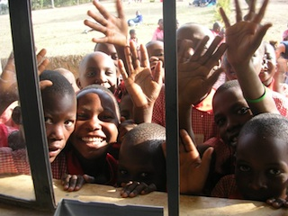
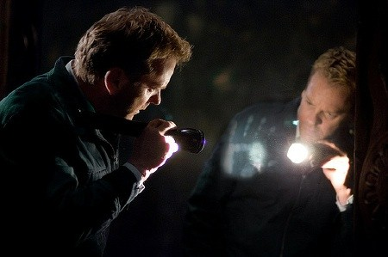
Two Views
Windows
Mirrors

Slide 24
Other Cultures
The world in which you were born
is just one model of reality.
Other cultures are not
failed attempts at being you:
They are unique manifestations
of the human spirit
Wade Davis, Anthropologist

Slide 25
Cultural Proficiency is attainable when. . .
We believe all students deserve high-level education
We believe students’ cultures are foundations upon which to build their educational experiences
We believe that we can educate each and all of our students

Slide 26
Voices that Resonate

