Slide 1




Trauma and the Refugee and Immigrant Experience
Saida Abdi, LICSW, MSW, MA,
BCH Refugee Trauma and Resilience Center (RTRC)

Slide 2
Refugee Trauma and Resilience Center
at Boston Children’s Hospital
Prevention and Intervention
Trauma Systems Therapy (TST)
Trauma Systems Therapy for Refugees (TST-R)
Research and Innovation
Somali Youth Risk and Resilience Project
Intervention Research: TST-R
Training and Resource Development
Refugee Services Toolkit (RST)
Cultural Brokering Training
Promoting Positive Social Identity/Identity in the Diaspora, an Online Community
Intervention Adaptation
Dissemination: TST-R

Slide 3
Introductions:
Who Is Here?

Slide 4
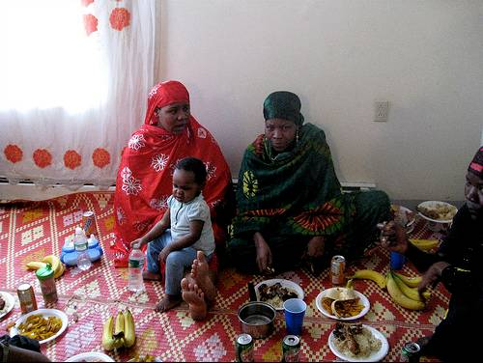
Who are refugees?
A person who is outside his/her country of nationality or habitual residence; has a well-founded fear of persecution because of his/her race, religion, nationality, membership in a particular social group or political opinion; and is unable or unwilling to avail himself/herself of the protection of that country, or to return there, for fear of persecution.
-- Article 1 of the 1951 U.N. Refugee Convention

Slide 5
Immigrants vs. Refugees
Difference in legal status: refugee vs. immigrant, documented vs. undocumented
Differences and similarities in experiences
Differences in access to services
Other special groups: unaccompanied minors, asylum seekers, temporary protected status

Slide 6
Refugee and Immigrant Trends
51.2 million displaced world wide (UNHCR, 2013)
Approximately half under the age of 18 (UNHCR, 2013)
810,000 under the age of 18 resettled in the US since 1980 (BRYCS, 2012)
Between 1994 and 2014, the percent of immigrant youth living in the United States increased from 18 to 25% (Child Trends Data Bank, 2014).
Immigrants will represent 30% of the children in U.S. schools by 2015 (Morse, 2005)
By 2040 it is projected that 50% of the youth in the U.S. will be children who were either born outside the US and immigrated, or whose parents are immigrants (Filindra et al., 2011)

Slide 7
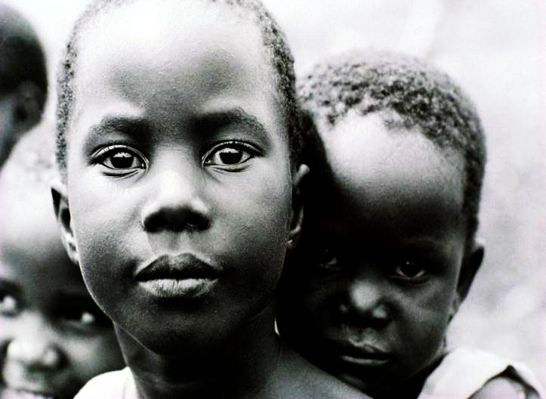
Refugee and Immigrant Experience and Trauma
Pre-migration, migration, and resettlement
Direct exposure to or witnessing of violence
Sexual assault and gender-based violence
Torture and detention
Disruption of family and community
Lack of access to basic resources
(food, water, medical care, shelter)
Long journeys on foot, living in refugee camps

Slide 8
Unique Experiences of Refugee Children and Adolescents
Trauma and displacement
Early childhood deprivation
Developmental issues
Parental trauma, impact on parenting
Displacement, impact on family
Acculturation, resettlement, isolation stressors
Prior school experience

Slide 9
Immigrants and Refugee and Mental Health
Those with high exposure to trauma at risk for PTSD, depression, anxiety, sleep problems, somatic complaints, behavioral, conduct, and school problems
Symptoms may diminish and recur over time
Role of parental adjustment
Importance of social environmental stressors
Resilience
For summary of literature on Children and Adolescents see http://www.apa.org/pubs/info/reports/refugees-full-report.pdf

Slide 10
Children and Trauma
1 in 4 children in the US will experience a traumatic event before the age of 16
  Follow up found 68%
Studies show 26-41% of inner-city students witnessed a shooting or stabbing
High rates of exposure to violence in country of origin, during displacement and resettlement
Our studies, Somali youth report averages of exposure to 6 and 7 traumatic events

Slide 11
Mental Health Symptoms in Child and Adolescent Refugees
PTSD, depression, anxiety, sleep problems, somatic complaints, behavioral, conduct, substance-related disorders, and school problems
Developmental, age-specific expression traumatic stress
Dose effect
Some studies suggest symptoms diminish and recur over time
Role of parental adjustment
RESILIENCE

Slide 12
Mental Health in adolescent refugees
  29-75% of refugee children show symptoms of PTSD (Allwood et al. 2002, Kinzie et al. 1999, Saigh, 1989).
  Kinzie and colleagues studied forty Cambodian adolescent refugees
    50% met criteria for PTSD two years after arriving in the United States
    53% met criteria for diagnoses of depression.
  Adolescents followed longitudinally over period of 12 years into adulthood.

Slide 13
PTSD and Depression in Cambodian adolescent refugees over course of 12 years
  3-year: PTSD 48% Depression 41%
  6-year : PTSD 38% Depression 6%
  12-year: PTSD 35% Depression 14%

Slide 14
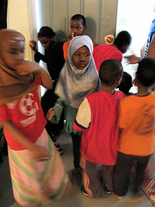
Consequences of traumatic stress
Social
  Drug abuse
  Anti-social behavior
  Isolation/withdrawal
Psychological
  Posttraumatic Stress Disorder
    Reexperiencing, Avoidance, Hyperarousal
  Depression
  Conduct disorder
  Emotion Regulation
Academic. . .

Slide 15
Resilience
Resilience traits: traditionally refer to characteristics of the individual that helps them to achieve desirable emotional and social functioning despite exposure to considerable adversity.
Resilience as a process: “Resilient mental health outcomes”
- (Masten, 1991; Cicchetti & Garmezy, 1993; Rutter, 1985. Masten & Garmezy, 1985; Werner & Smith, 1992; Luthar, 1996).

Slide 16
Stress-Adjustment Paradigm
(Lazarus & Folkman, 1984)
Mental
Health
Adjustment
Resources
Individual Characteristics
-i.e. coping skills
Family Characteristics
    -i.e.social support
Community Characteristics
    -i.e. belonging/
    connectedness
Stressors

Slide 17
Protective Processes
Three sets of protective factors are thought to relate to the “development of resilience” in children (a process):
1) attributes of the individual child
2) attributes of a child’s family
3) characteristics of the larger social environment
- (Masten, 1991; Cicchetti & Garmezy, 1993; Rutter, 1985. Masten & Garmezy, 1985; Werner & Smith, 1992).

Slide 18
Refugee Youth Core Stressors

Slide 19
School Stressors
Lack of formal schooling experience
Placement in schools by age
Difficulties assessing learning disabilities, etc.
Lack of familiarity with societal norms related to school
Language barriers with parents
Sense of school belonging

Slide 20
Family Stressors
Acculturation differences
Language/communication differences
Reunification for some families
Parent adjustment
Family violence

Slide 21
Community Stressors
Acceptance/discrimination
Social isolation/Loss of traditional social support
Community violence
Challenges for unaccompanied minors
Access to services
DCF/DYS involvement

Slide 22
Resettlement Stressors
Difficulties finding adequate housing
Difficulties finding employment
Loss of community support
Lack of access to resources
Transportation difficulties
Lack of familiarity with school system

Slide 23
Acculturation Stressors
Conflicts between children and parents over new and old cultural values
Conflicts with peers related to cultural misunderstandings
The necessity to translate for family members who are not fluent in English
Problems trying to fit in at school
Struggle to form an integrated identity including elements of their new culture and their culture of origin

Slide 24
Isolation Stress
Feelings of loneliness and loss of social support network
Discrimination
Experiences of harassment from peers, adults, or law enforcement
Experiences with others who do not trust the refugee child and family
Feelings of not “fitting in” with others
Loss of social status

Slide 25
Normal Reactions to
Traumatic Events
When children have a traumatic experience, they react in both physiological and psychological ways:
  Fear or horror
  Increased physiological arousal (e.g., heart rate, sweating, agitation, crying, stomachaches, hyper-alert, emotionally upset)
  Avoidance (e.g., freezing, hiding, dissociation)
Fight or flight response, how our body protects us, survives

Slide 26

The Trauma System
“The amygdala leads a hostile takeover of consciousness by emotion (Joseph LeDoux)”

Slide 27
Traumatic stress is mediated by…
Survival circuits
freeze
fight
flight
Notes:
There are no right answers, but there are 3 hardwired reactions that we tend to have

Slide 28

Survival circuits are adaptive… Unless they are triggered in non-threatening situations

Slide 29
Survival circuits – what’s supposed to happen?
Step 4:
Doing something about it
Step 1: Picking up the threat information
Step 3: Making a more accurate appraisal
Step 2: Deciding on its importance for survival
Notes:
This is how it works normally

Slide 30

Survival circuits – what happens in a child with traumatic stress?
Notes:
This is how it works in the brain

Slide 31

Survival Circuits are regulated by…
safe and healthy relationships

Slide 32
Trauma System: Social-Ecological Model
Culture
Neighborhood
Peer Group
School
Self-Regulation Interventions
Family
Individual
Social environmental interventions

Slide 33
The Trauma System
A traumatized child who is unable to regulate emotional states,
A social-environment/system-of-care that cannot help contain this dysregulation.

Slide 34
Goals of Trauma Systems Therapy(TST)
Treatment must directly address the core developmental problem of traumatic stress; the dysregulation of emotional states when confronted with a stressor.
Treatment must directly address the social ecology.
Treatment must be compatible with systems-of-care.
Treatment must be disseminate-able and sustainable.

Slide 35
Trauma and Schools

Slide 36
Trauma Can Impair Learning
Single exposure to traumatic events may cause jumpiness, intrusive thoughts, interrupted sleep, and nightmares, anger and moodiness, and/or social withdrawal any of which can interfere with concentration and memory.
From Child Trauma Toolkit for Educators, National Child Traumatic Stress Network, www.nctsn.org

Slide 37
Trauma Can Impair Learning
Chronic exposure to traumatic events, especially during a child’s early years, can:
    Adversely affect attention, memory, and cognition
    Reduce a child’s ability to focus, organize, and process information
    Interfere with effective problem solving and/or planning
    Result in overwhelming feelings of frustration and anxiety
From Child Trauma Toolkit for Educators, National Child Traumatic Stress Network, www.nctsn.org

Slide 38
Trauma Can Impact
School Performance
Lower GPA
Higher rate of school absences
Increased drop-out
More suspensions and expulsions
Decreased reading ability
From Child Trauma Toolkit for Educators, National Child Traumatic Stress Network, www.nctsn.org

Slide 39
Culture, Trauma, and PTSD
Although much is known about trauma and youth generally, there are problems in applying this knowledge broadly to all groups:
  Culture affects symptom expression, help seeking patterns, healing mechanisms, meaning ascribed to trauma, type of trauma experienced
    Cultural bereavement, cultural trauma, generational trauma
  Refugee experience affects ongoing stressors
    Acculturation, discrimination

Slide 40
What is Culture?
“Culture is a society’s style, its way of living and dying…attitudes towards women, children, old people and strangers, enemies and allies; eternity and present; the here and the now and beyond”
-Octavio Paz

Slide 41

What is Cultural Competence?
“Cultural and linguistic competency is a set of congruent behaviors, attitudes, and policies that come together in a system agency, or among professionals that enable effective work in a cross-cultural setting”
Terri Cross, 1989

Slide 42
Why is Cultural Competence Important?
Providing services to diverse urban communities
Many times clinicians and school staff may come from different cultural backgrounds (ethnicity, SES, education, etc.)
Stigma and different cultural perceptions of mental health and help seeking
Disparities in health and mental health access
Mental health unique service because relationship and alliance key to success
Failure to consider cultural issues in services can adversely affect quality of care, outcomes, patient satisfaction/engagement and cost
Javier & Bishop, 2006

Slide 43

Cultural Humility Video
Cultural Humility Video
Cultural Humility:
by Vivian Chavez

Slide 44

Strategies for self reflection and life long learning
Understand your own worldview and be willing to challenge your paradigms
Be willing to unpack your own privilege and power

Slide 45
Cultural Competency VS. Cultural Humility
Which one should we adapt?
Learn about culture of your clients?
Self Reflection (institutional and ind.)
How about both?
Know your clients
Know yourself
Always ask and never assume

Slide 46
What can we do?
"A journey of a thousand miles starts with one step.”
                -Lao-tzu, ancient Chinese philosopher

Slide 47

What color are your glasses?

Slide 48
Trauma System: Social-Ecological Model
Culture
Neighborhood
Peer Group
School
Self-Regulation Interventions
Family
Individual
Social environmental interventions

Slide 49
APA Recommendations for Services
Comprehensive, community based services—holistic approach (e.g., assess all needs, resources, collaborate with school, community)
Provide culturally competent services (e.g., respect cultural beliefs, client-focused goals, cultural brokers from community)
Integrate evidence-based practice with practice-based evidence (e.g., assess history with care, psychoed, strengths-based, use trauma treatments flexibly)
Notes:
Use comprehensive, community based services—holistic approach
-assess postdisplacement needs
-assess resettlement stressors
-assess resource availability
-engage and collaborate with the community
-work directly with war-affected child’s school
Provide culturally competent services
-demonstrate openness to & respect of cultural beliefs
-assess linguistic and cultural components of MH symptoms
-elicit client focused goals and strengths
-engage with cultural brokers in the community
Integrate evidence-based practice with practice-based evidence
-assess history of trauma exposure with care and patience
-use normalization and psychoeducation
-maintain strength based focus and acknowledge resiliency
Use trauma-focused treatments flexibly

Slide 50
Refugee and Immigrant
Barriers to Care
Reluctance to seek out services
  Stigma around mental health
  Lack of resources
Families overwhelmed by their own migration experiences
  May not be able to recognize needs of children
Unaware of what services are provided/Services not helpful
Lack of linguistic and cultural accessibility
Limited referral networks from schools, pediatrics etc.
  Different explanatory model/different solution

Slide 51
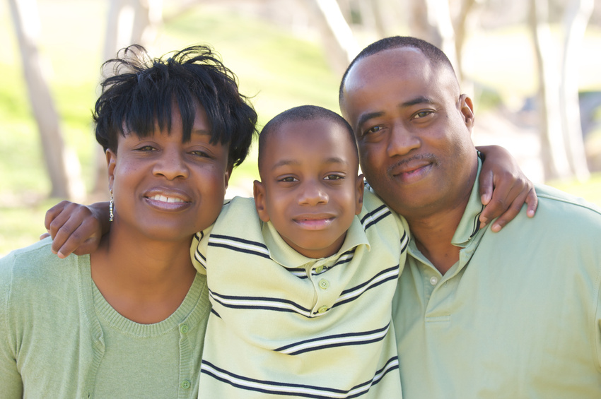
TST-R Addresses the Trauma System
TST-R is an adaptation of TST for refugee youth and their families. TST-R takes into account the context of the refugee and immigrant experience and barriers (e.g., stigma, language, distrust) to engaging in mental health services.

Slide 52
TST-R Objectives
Engagement of refugee children and families in services
Decrease stigma of mental health
Increase identification of refugee youth with mental health needs
Provide sustainable culturally- and linguistically-appropriate school-based mental health services

Slide 53
Trauma Systems Therapy-Refugees (TST-R)
Cultural Brokering
Groups
TST
Community Outreach

Slide 54
Continuum of Cultural Sensitivity
Increasing cultural knowledge of providers
Child
Increasing MH capacity in refugee community
School
Community

Slide 55
Beliefs and Value Systems
Collective Culture (Middle East, Africa, Asia) | Western/Individualistic Culture
Interdependence | Self-Reliance/Boundaries, roles, and limit setting
Time is Cyclical | Time is Finite
God’s Will | Human Mastery/Science and Knowledge
Hope-maintaining/Things are implied Expect shared understanding and knowledge, Shared context, thus no need to verbalize | Truth-Telling/Verbalizing feelings and thoughts Clearly stating positions/right to know Not assuming shared knowledge
Communication Narratives | Direct answers, to the point
Relationships-historical | Relationships- objective/distance
Collective identity Shared experiences and shared feelings Are important to the relationship | Clinical/professional relationships that avoid transference / countertransference
Information is shared among family and community *What is shared vs. burden | Confidentiality
Expertise of clinician respected Seeking direction | Patient rights respected Solutions are co-created with client

Slide 56
Barriers to Cultural Competence
Institutional Barriers
Individual Barriers
Population Barriers

Slide 57
Examples of Barriers
Culture of the Institution (how we do)
Limited cultural provider training (what we know)
Time Constraints (what we can do)
Limited cultural of support for Employees(who does what)
Patient expectations (here vs there)
Different communication styles
Vastness of the field (how many cultures do you serve)

Slide 58
Key Aspects of Treatment Engagement
Reducing Stigma
Increasing access by creating more responsive service systems
Enhancing education for practitioners
Developing community and systems partnerships
Working with members of specific cultural groups
Meeting needs of families
Cultural context and language
Ongoing partnerships

Slide 59
Questions to Ask
What is the family’s priority problem?
What is health/Mental health in the culture?
What is the caregiver’s understanding of the child’s condition?
How is mental illness expressed in this culture?
What has been the family’s mental health/health services experience?
When, who and where do people go for help for this type of a problem?
What do they expect from you as a provider?

Slide 60
Creating a More Welcoming Environment
How do you say hello?
The efficient secretary
Build a relationship early on. Do not meet in a crisis..
Be curious, find out about their culture, food, music, what can they teach you
Share relationship building and positive experiences (food, humor, language, stories, music, games)

Slide 61
What Else Can I Do?
Addressing family basic or identified needs
Providing psychoeducation to families about developmental presentations traumatic stress, school systems, etc.
Thinking preventively, involving in community-based activities
Help families connect to cultural, religious, mentoring, and community organizations
Promoting communication within families
Respecting family roles, not using children as interpreters

Slide 62
What Else Can I Do?
Inter-agency partnerships between schools, mental health, and community agencies
Accessing advocacy services
Knowledge of cultural and other resources for teachers, mental health professionals, etc.
Knowledge of continuum of behavioral health care for children in MA (CBHI)
Referring those at high level need for further assessment
Parent and family engagement

Slide 63
Access to services
Build partnerships between gateway providers (religious and community leaders) and mental health professionals
  Understanding each other’s approach
  Respecting and supporting each other’s approach
Bring parents into the process
  Outreach and education, anti stigma efforts
Position mental health services in service systems that are accessed (e.g. schools)

Slide 64
Barriers to Mental
Health Care
Strategies to Address
Barriers
Distrust of Authority/
Power
Community
Engagement
Partnership of Providers & Cultural Experts
Linguistic & Cultural
Barriers
Stigma of Mental Health
Services
Embedding Services in
Service System
Primacy of
Resettlement
Stressors
Integration of
Concrete Services

Slide 65
TST-R Adaptation of Trauma
Systems
Therapy
Culture
Neighborhood
Peer Group
School
Self-Regulation Interventions
Family
Individual
Social environmental interventions

Slide 66
Additional Resources
For more information on resources related to supporting refugee children and families, please visit: http://nctsn.org/trauma-types/refugee-trauma
This webpage provides the most current information about refugee youth, their needs and experiences, and provides guidance for service providers including teachers and educators

Slide 67
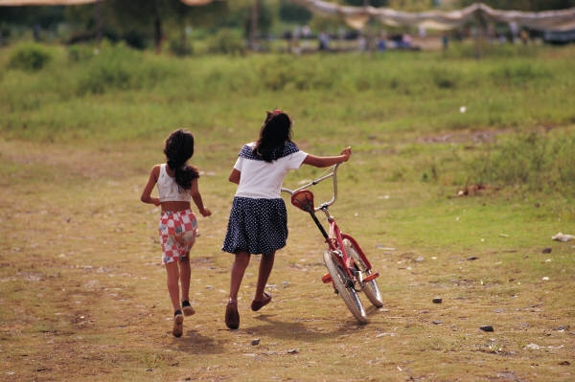
Thank You!
Contact Information:
Saida.Abdi@childrens.harvard.edu

